Slide 1
Warehouse Management System
For perishable goods

Slide 2
Who would be needing it ?
A food delivery company looking for an optimized way to predict and tackle the problem of wastage and out-of-stock situations

Slide 3
Why would anyone need ?
For a proper procurement planning to keep a record of the raw materials and goods that are dealt with, mostly perishable items.
Managing delivery ways and techniques to ensure on-time and efficient manner of dispatchment of items.
Keeping the users updated about various types and quantity of foodstuffs available, so that they can purchase both from website as well as from the app.
Finding out ways to deal with the left over non-saleable goods to make for its purchase costs and other investments.

Slide 4

Lot more to do !!!

Slide 5
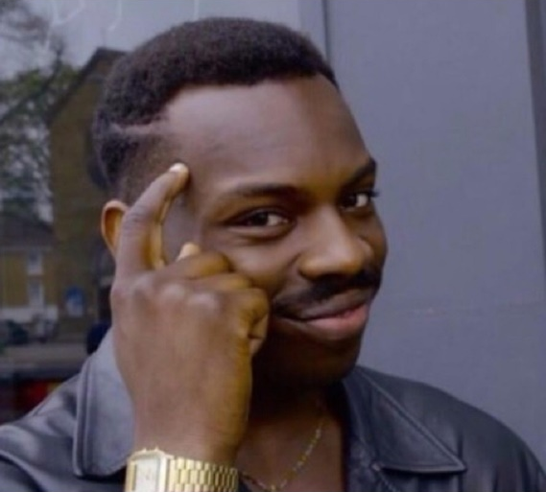
Here, is a way to develop a smart system to check,
manage and implement all the solutions together as a single whole thing
Well don’t worry

Slide 6
Most important thing for a warehouse is to maintain the required amount and variety stock which would attract large number of customers
SO, WE NEED TO STUDY THE MARKET TRENDS & DEMANDS

Slide 7
Our proposal
Novelties and Uniqueness

Slide 8
Salient unique features of the model
A robust ensemble ML model handling all the diverse amount of data
Ecommerce integration and tracking to keep a the track on predicted vs real demand and hence constantly improving our model
Can be easily merged in to various platforms , hence easily accessible for use by stakeholders of all types of perishable goods
Due to the unique in its build design this generalised model could be easily made region and good specific and easily conceivable by the stakeholders

Slide 9
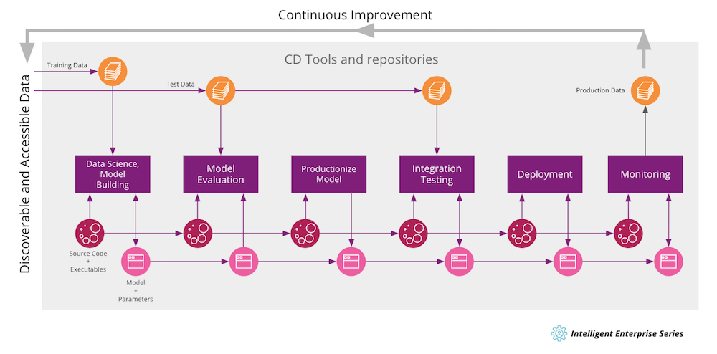
Uniqueness : Continuous Improvisation

Slide 10
Our proposal
Bussiness and social impact

Slide 11
The organisation responsible for the production and distribution of perishable goods(be it govt. organisations or private company
High jump in benefits by correct estimation of demands
Reduction of storage losses due to tackling of over expectation.
The general public or the consumer
Easy availability of the required perishable goods
Availability of life saving pharmaceuticals in more abundant amount due to correct demand estimation.
Optimisation of transportation cost due accurate region wise demand forecast.
Immediate demands are more easily fulfilled instantly as compared to business s models without accurate demand forecasting.

Slide 12
Our proposal
Technological Stack – Data Collection and Prediction Model

Slide 13
Collecting and feeding the data
Final Prediction
Sales data and other historical data
Manual inputs from scientists, economists, and other experts to handle the prediction of extreme unforeseen situation.
Data collected from websites, blogs and reports
Forecasting data of extreme climatic condition and its effect on the production and demand of perishable goods
Data collection
Based on users reaction across social media
As our model requires variety of data hence variety of methods like web scrapping and collection of premade dataset would be done.
After that relevant data would be collected.
And then the required features is to be generated using required techniques

Slide 14
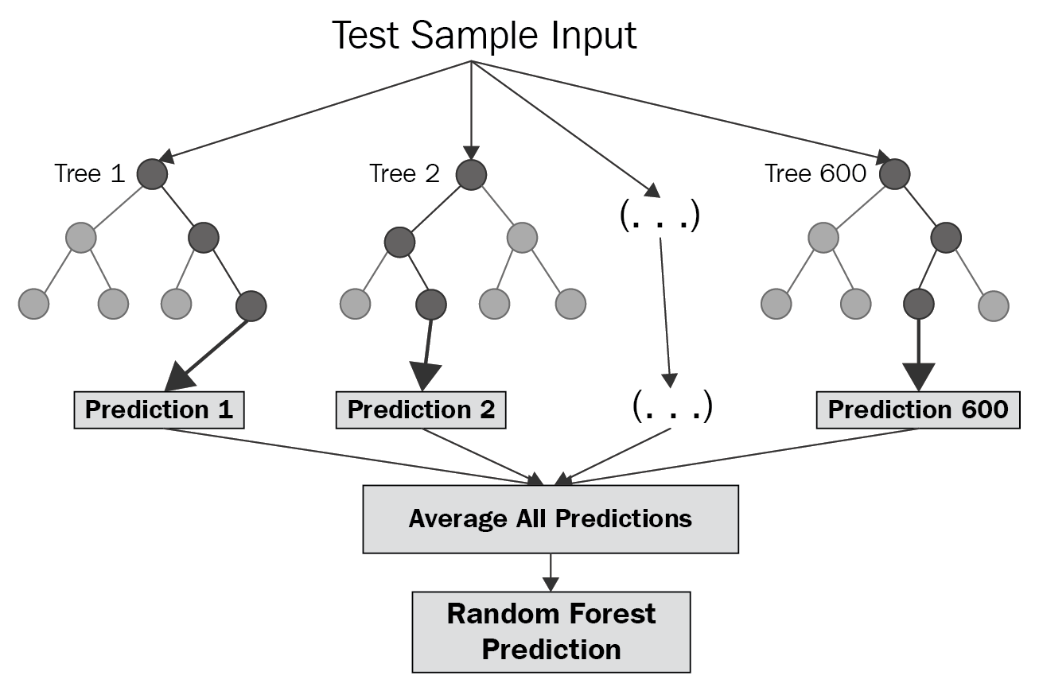
The prediction model
Due to the large variety data to be used we would use different ML based prediction model to tackle this.
Then we would use random forest inspired ensemble model to merge and enhance the accuracy of the prediction.
Or short term data analysis ARIMA based model would be used and for long-term LSTM based model would be used and other additional models for feature extraction and dealing with such large variety of data

Slide 15
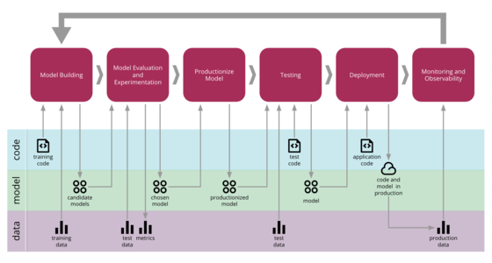

Slide 16
Other Benefits
Technological Stack - Web and app service

Slide 17
Manual Adjustments/ override, when recommended by experts
Smart Notification. (using TS Messages)
Hyper Local Forecast
Real Time monitoring and accuracy monitoring.
Flexible and transparent adjustment
E-commerce Integration. (sync data from ecommerce platform to cross verify the real time performance vs forecast)
Trend Detection feature
Immediate update for customers as well as for the company

Slide 18
Scope of work
The whole warehouse storage model primarily depends on variety of large scale data, hence technicians and data scientists are needed to perform this tasks extensively.
To make this feature more region and product specific an efficient data collection team is required.
Data scientists are also required for feature engineering and for accessing the performance of the model.
Our prediction models requires the inputs from experts like economists and environmentalists etc. for very accurate prediction in extreme unforeseen situation.
A team to handle and update the web/ mobile app.

